Slide 1

Mental health analysis of students using Sentiment recognizer

Slide 2

Contents
1. Introduction
2. The Problem
2. Proposed Idea
3. Our Solution
4. Sentiment Analysis Module
5. Behavioral Analysis Module
6. Chatbot
7. Controlflow
8. Demonstrations
9. Advantage of Intel Products
10. Further Improvements

Slide 3
Introduction
Stress is the physical and mental response of the body to demands made upon it. It is the result of our reaction to outside events, not necessarily the events themselves.
Numerous dead lines,multiple examinations and peer pressure can push students into a vicious cycle of severe stress.

Slide 4
The Problem
Stress in students many times leads to psychological effects like problems with cognitive functioning, anxiety and depression.
In a few cases, students may even take drastic steps.
Cigna 360 Well-Being survey revealed that 95 percent of Indian millennials between the age group of 18-34 are stressed. One in eight Indians has serious trouble in dealing with stress. This is even worse in youngsters as they are not used to it.

Slide 5
Proposed Idea
Consequences can be avoided by early detection of stress and assessment of mental health.
Social media activity provides an insight into the mental state of the student
Classroom behavior is also a valuable tool as students spend significant amount of their time in classes.
We use the data generated by them for early detection of symptoms and offer assistance at the right time.

Slide 6
Our Solution
Functional Modules:
Sentiment Analysis Model - To understand the sentiment in the posts.
Behaviour Analysis Model - To understand the classroom behaviour of students.
Chatbot - To enable continuous emotional support and evaluation of students mental health.

Slide 7
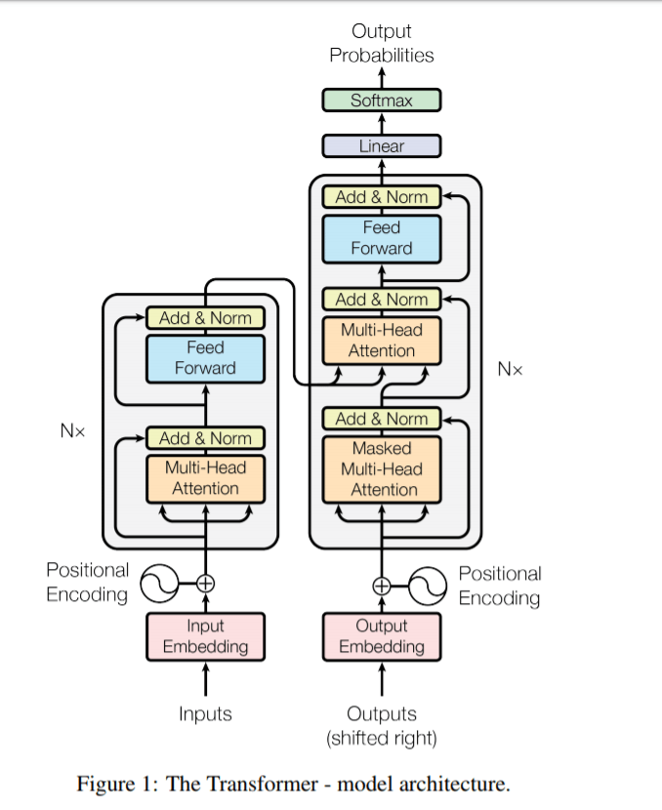

Sentiment Analysis Module
A deep learning based module which can classify sentences into categories ie. Negative and Positive(prototype)
Uses transformer architecture(BERT)
for classification task.
Trained on twitter data on Intel NLP architect.

Slide 8

Behavioral Analysis Module
A computer vision based module which can detect the attentiveness, emotion and drowsiness of students.
Built using Intel OpenVINO toolkit. Standard models taken from Intel-OpenVINO model zoo.

Slide 9
Chatbot
Conversational agent which provides emotional support during distress by thought provoking activities and administers standard tests for analyzing mental state of student.
Uses sentiment analysis model for understanding students responses, later aggregates them to generate a final risk score.

Slide 10
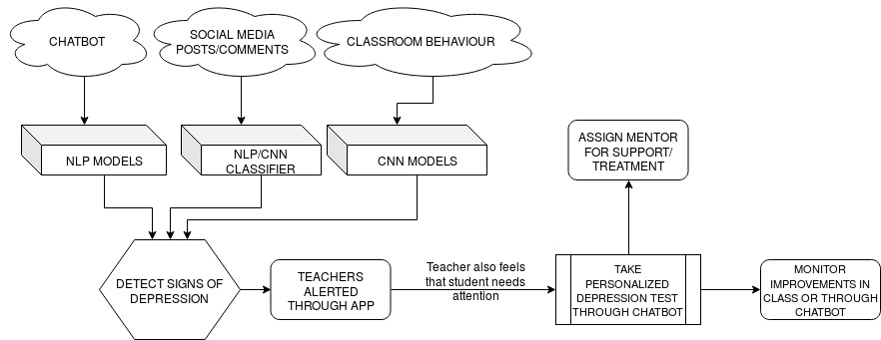
Control flow

Slide 11
Advantages of Intel tools
NLP architect provides a quick and easy way for prototyping state of the art architectures.
LSTM based architecture - Training set - , Training time and accuracy.
Bert based architecture implemented using NLP architect - Training set - , Training time and accuracy.
Open Vino has a plethora of pretrained models, openvino provides high throughput along with quick inference on heterogeneous platforms like cpu, intel-stick etc..
Openvino can be deployed on edge ie in mobiles . reduces privacy risk and inference time.

Slide 12
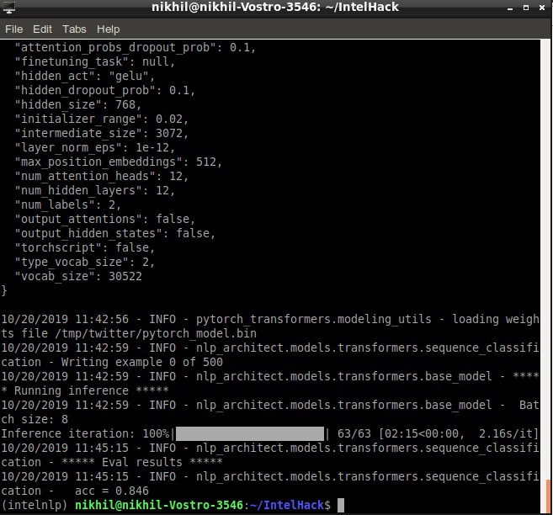
Demo - 1 Sentiment Analyser

Slide 13
Demo -2: OPENVINO Behaviour Analysis

Slide 14
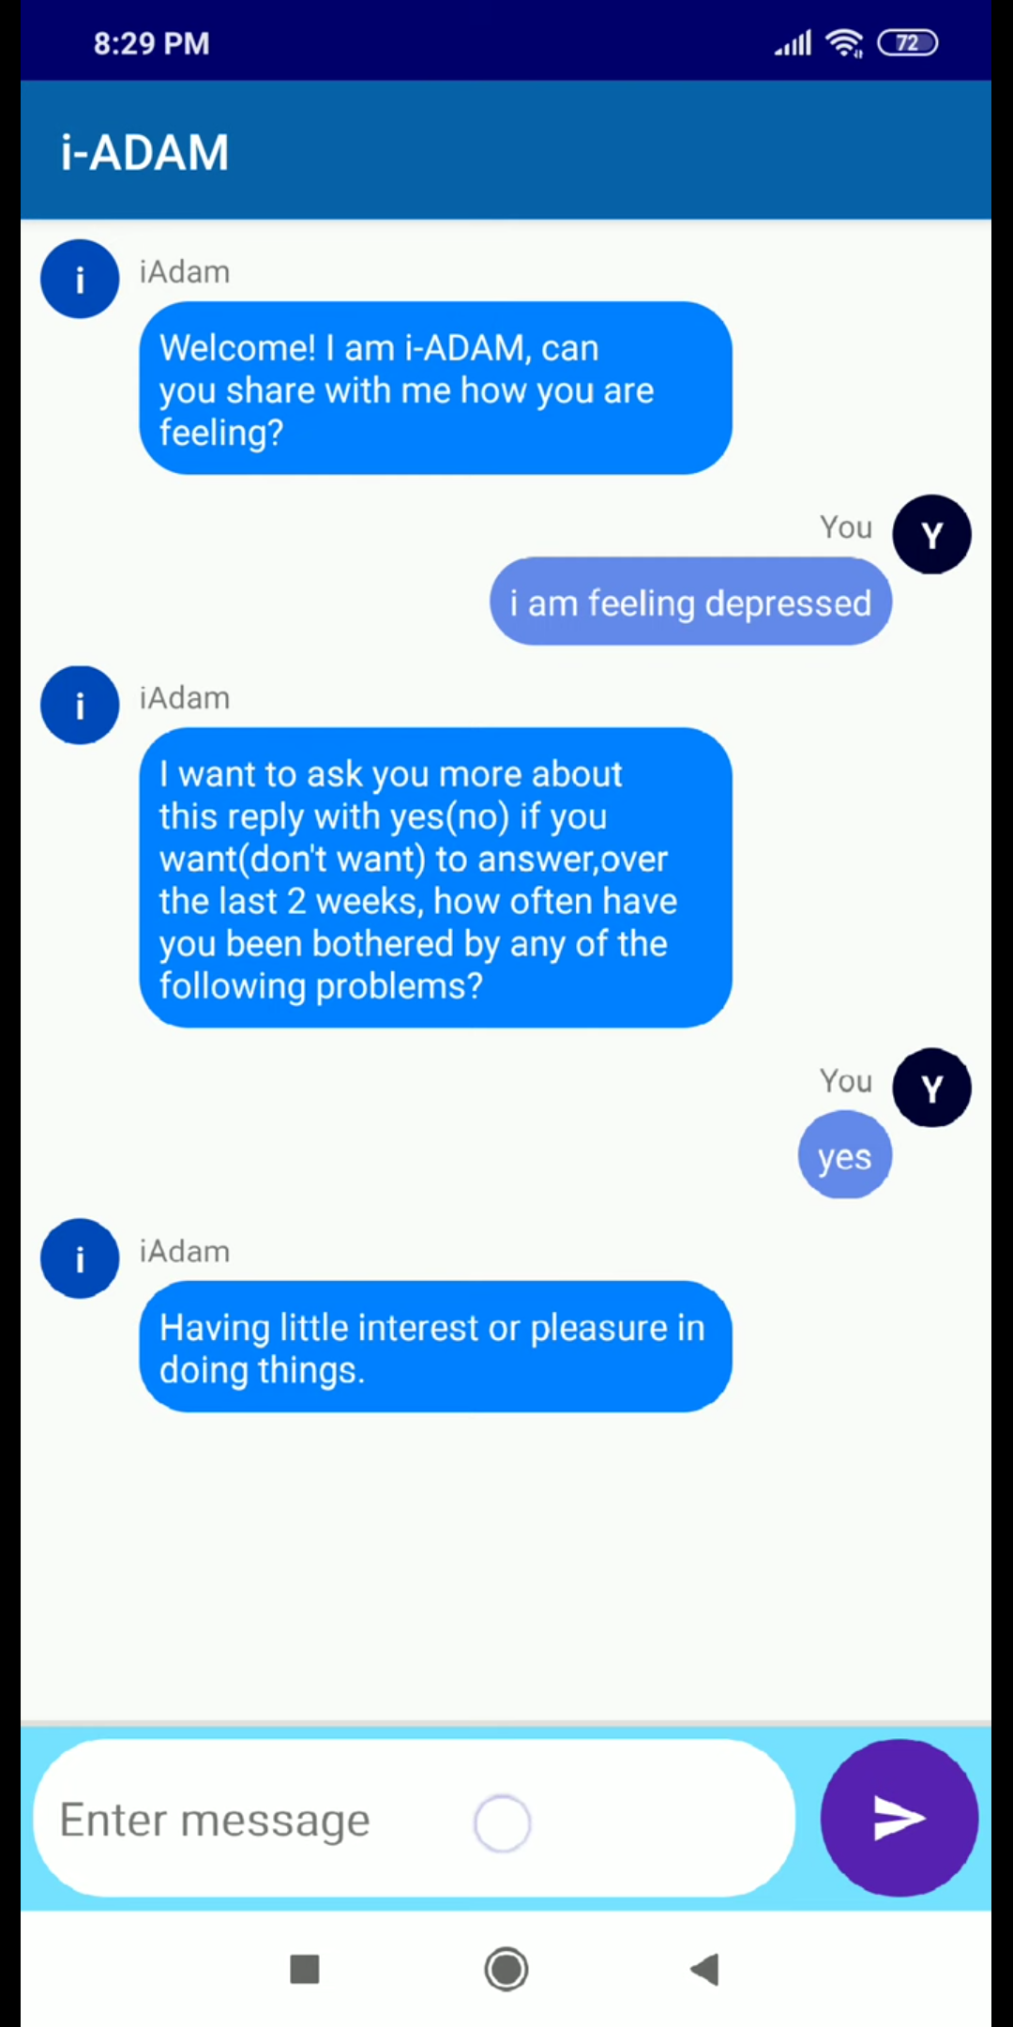
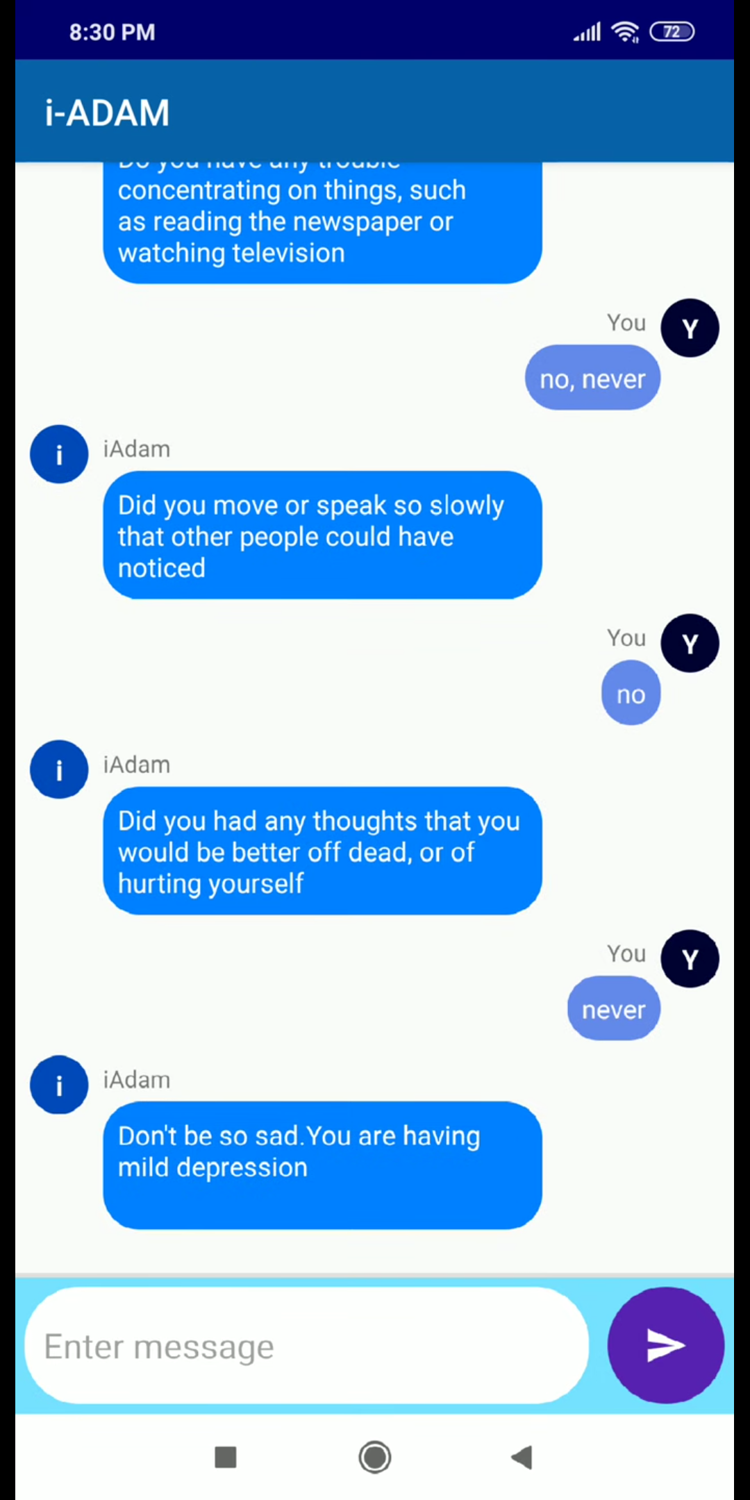
Demo-3 Chatbot

Slide 15
Further Improvements
Adding finer classes into sentiment recognizer model. Ie Anger, guilt, suicidal etc.
Likes, comments and images can also be used for sentiment analysis.
Behavioural model can be used for live feedback of class for teachers.
Reports of psychologists can be analyzed and a machine learning based solution can be built for administering tests.
Integration of study planners into chatbot for further ease of stress.

